Slide 1
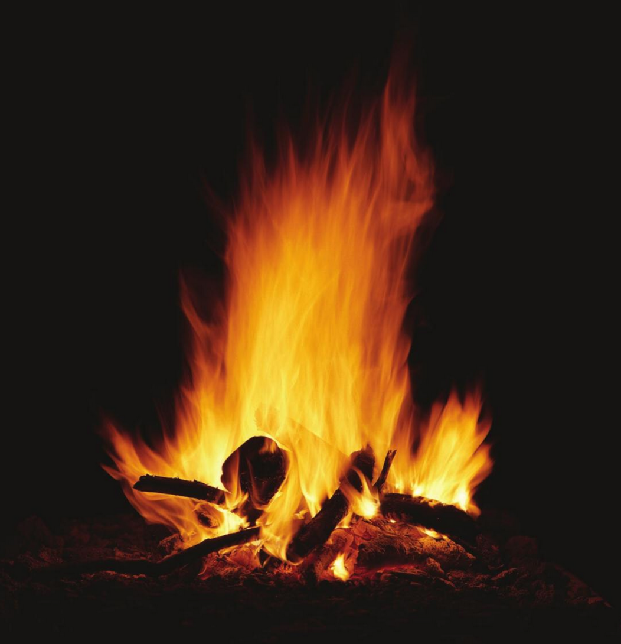
Fuel = something that burns

Slide 2
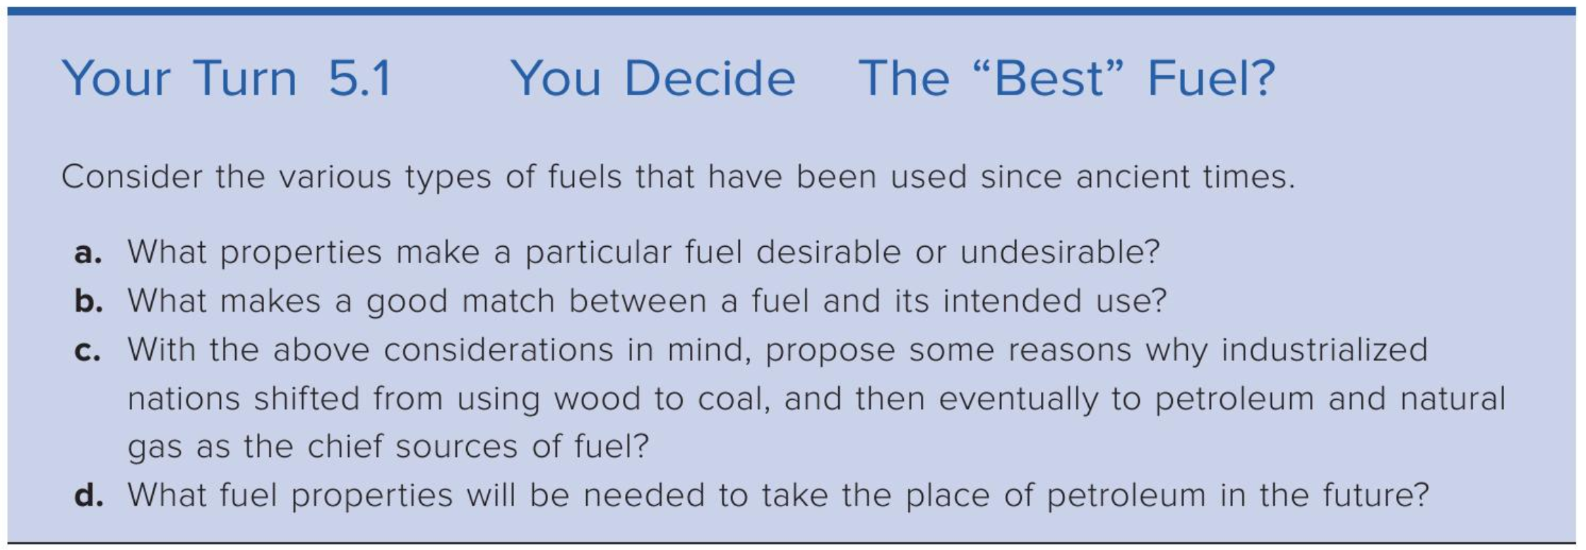
Criteria for a good fuel?

Slide 3
Some practical considerations …
A good fuel …
Ignites easily at a low temperature
Produces a lot of heat
Can be safely stored and transported
Is inexpensive
Produces by-products that are not harmful

Slide 4
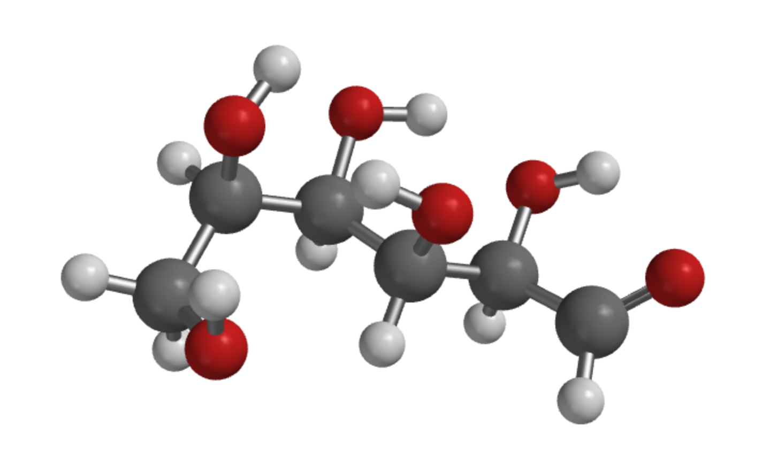
Fuels come from photosynthesis
Glucose (a simple sugar)

Slide 5
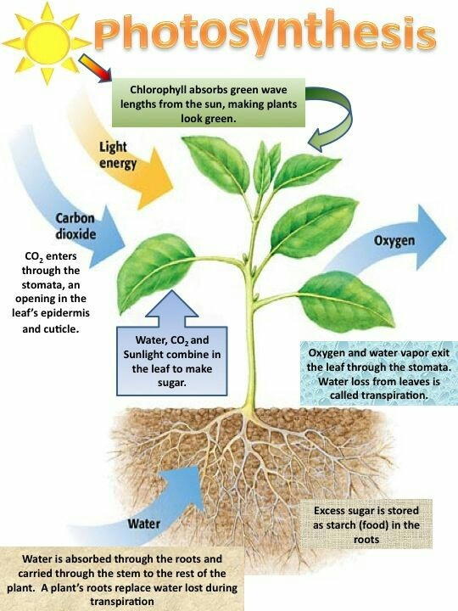
Living plants turn glucose into lots of other forms
Leafy matter
Wood
More complex sugars (sucrose)
Carbohydrates (starch)

Slide 6
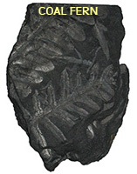
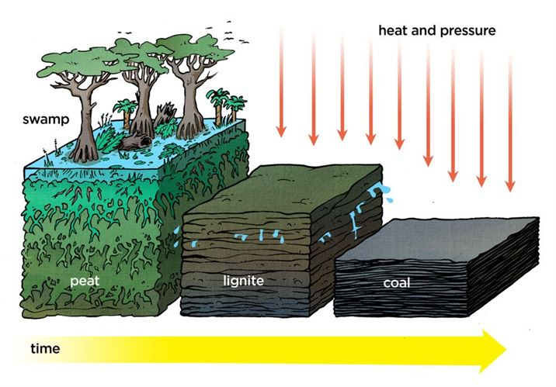
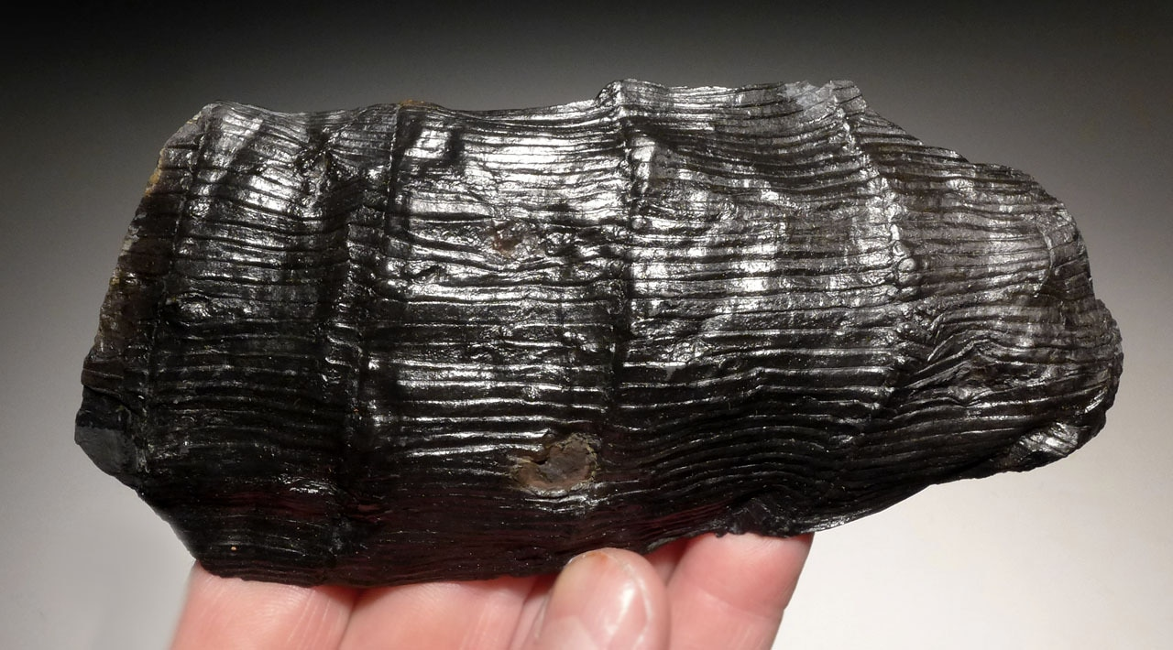
Coal consists of all this + chemical changes underground
Coal is mostly carbon
(60-80%)

Slide 7
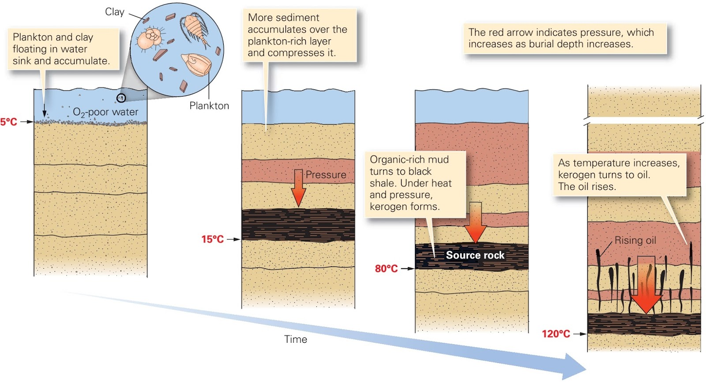

First to form is “kerogen”

Slide 8

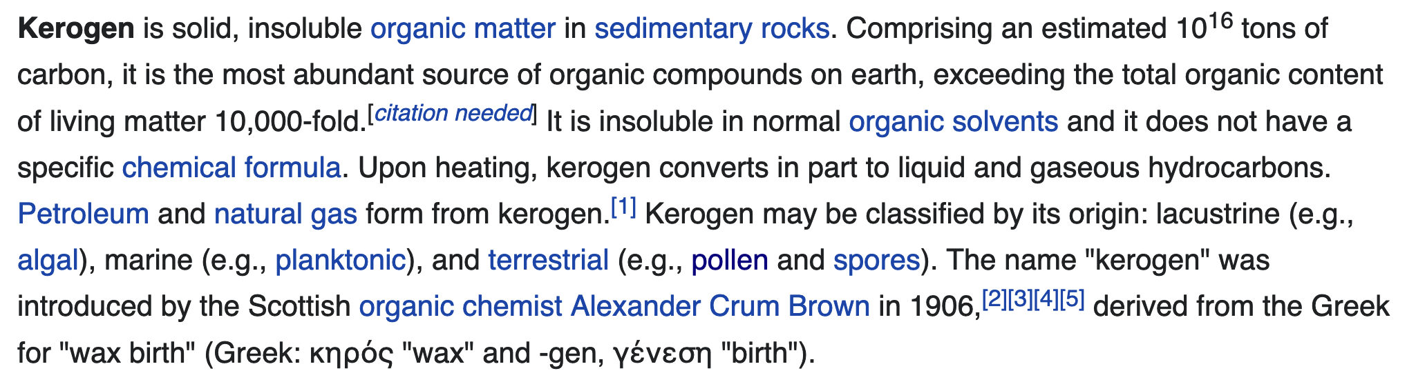
What is kerogen?

Slide 9
After kerogen, oil and gas

Slide 10
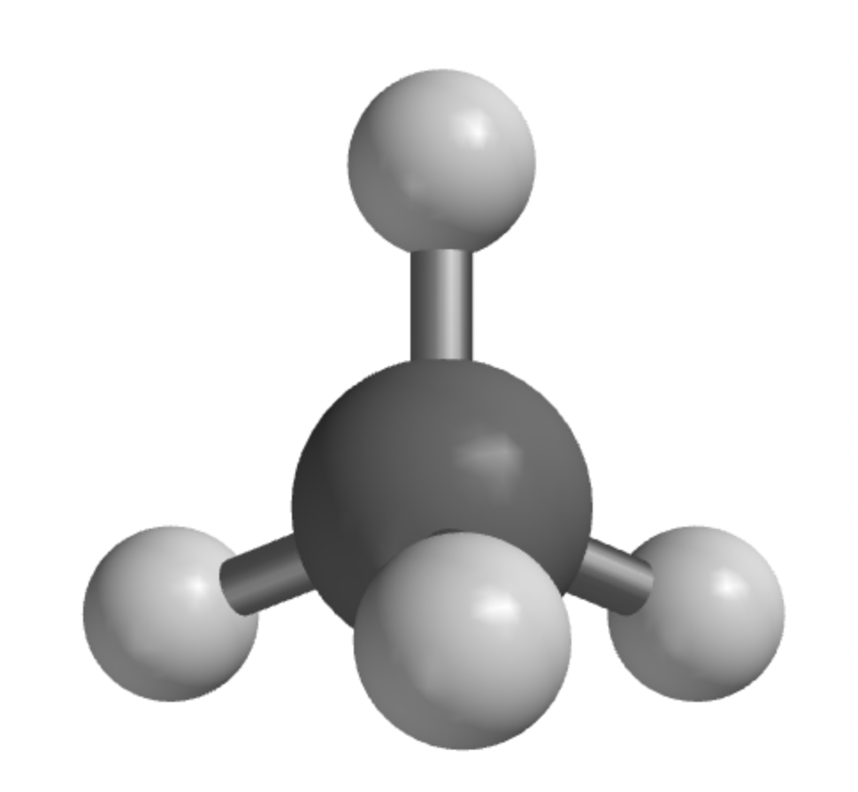
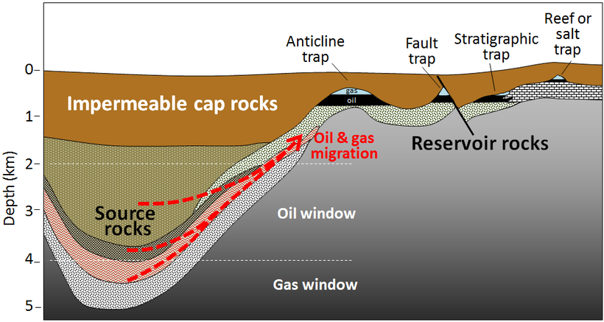
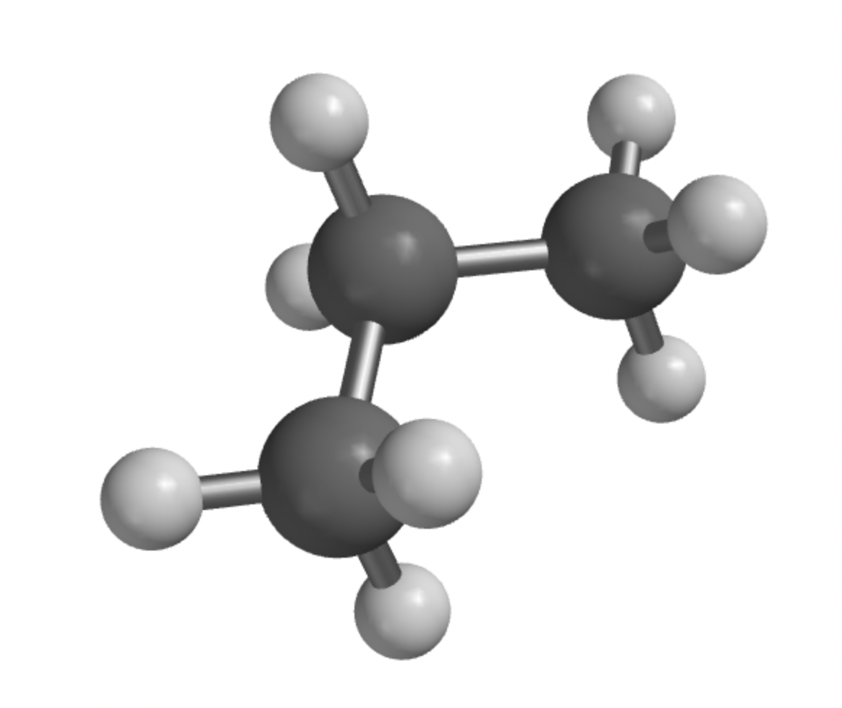
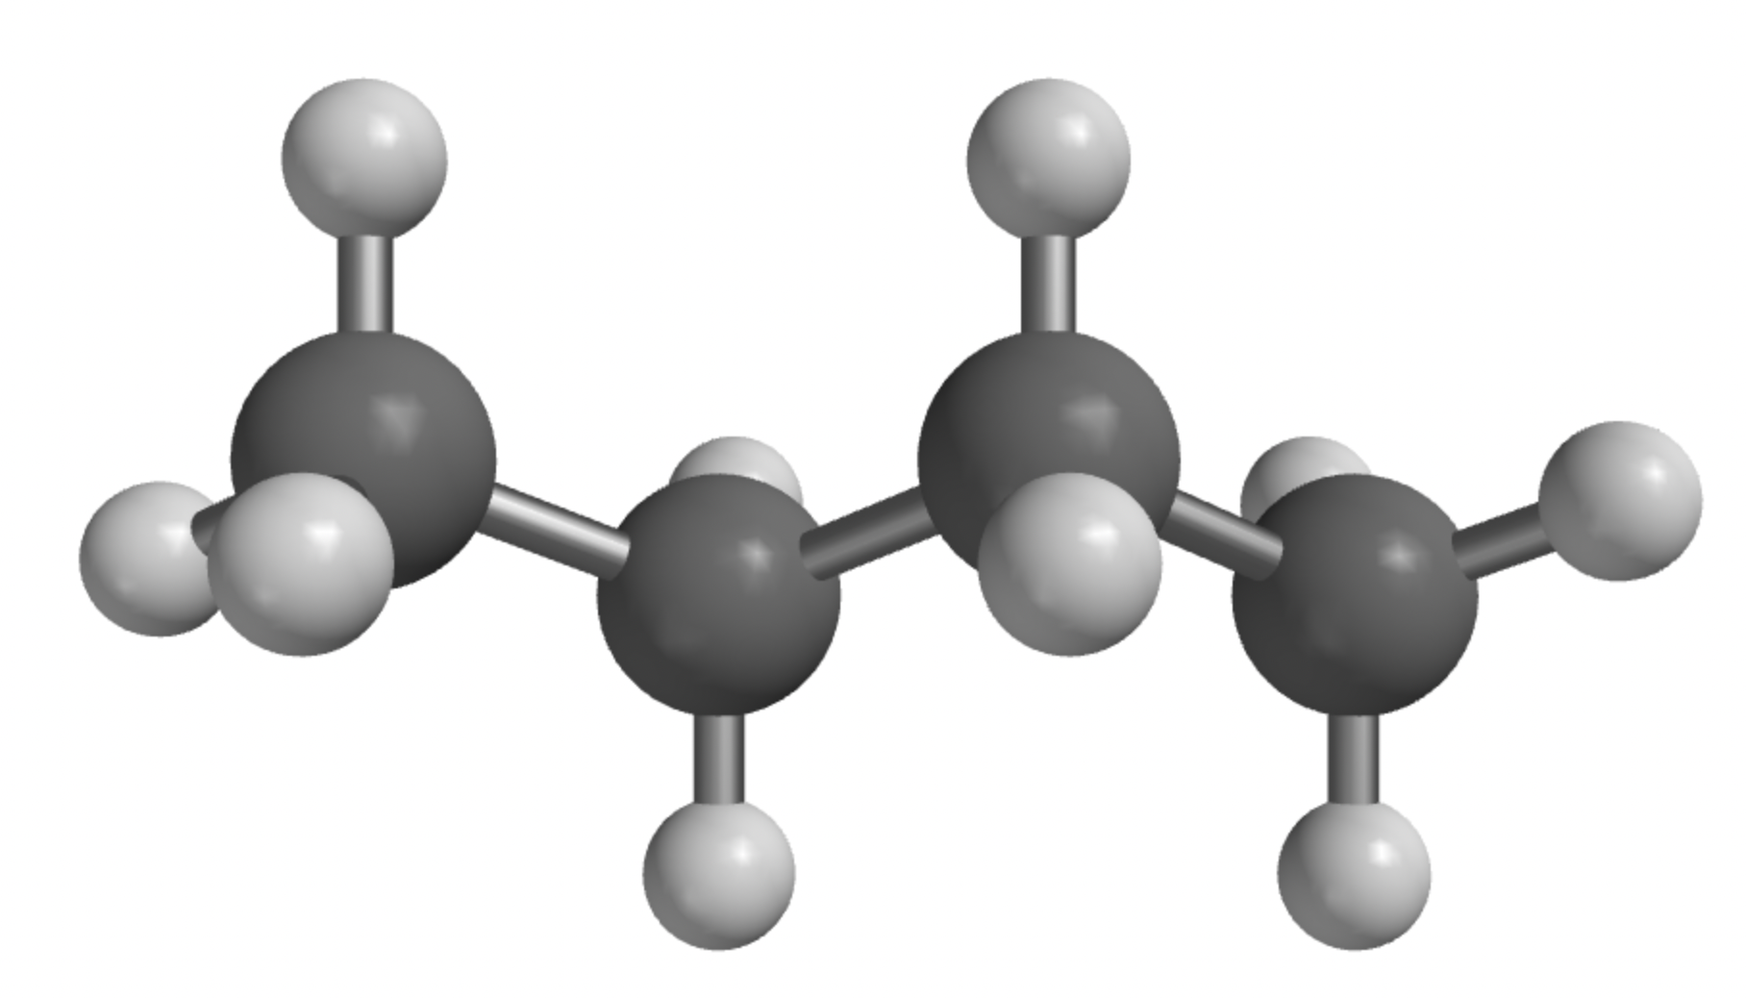
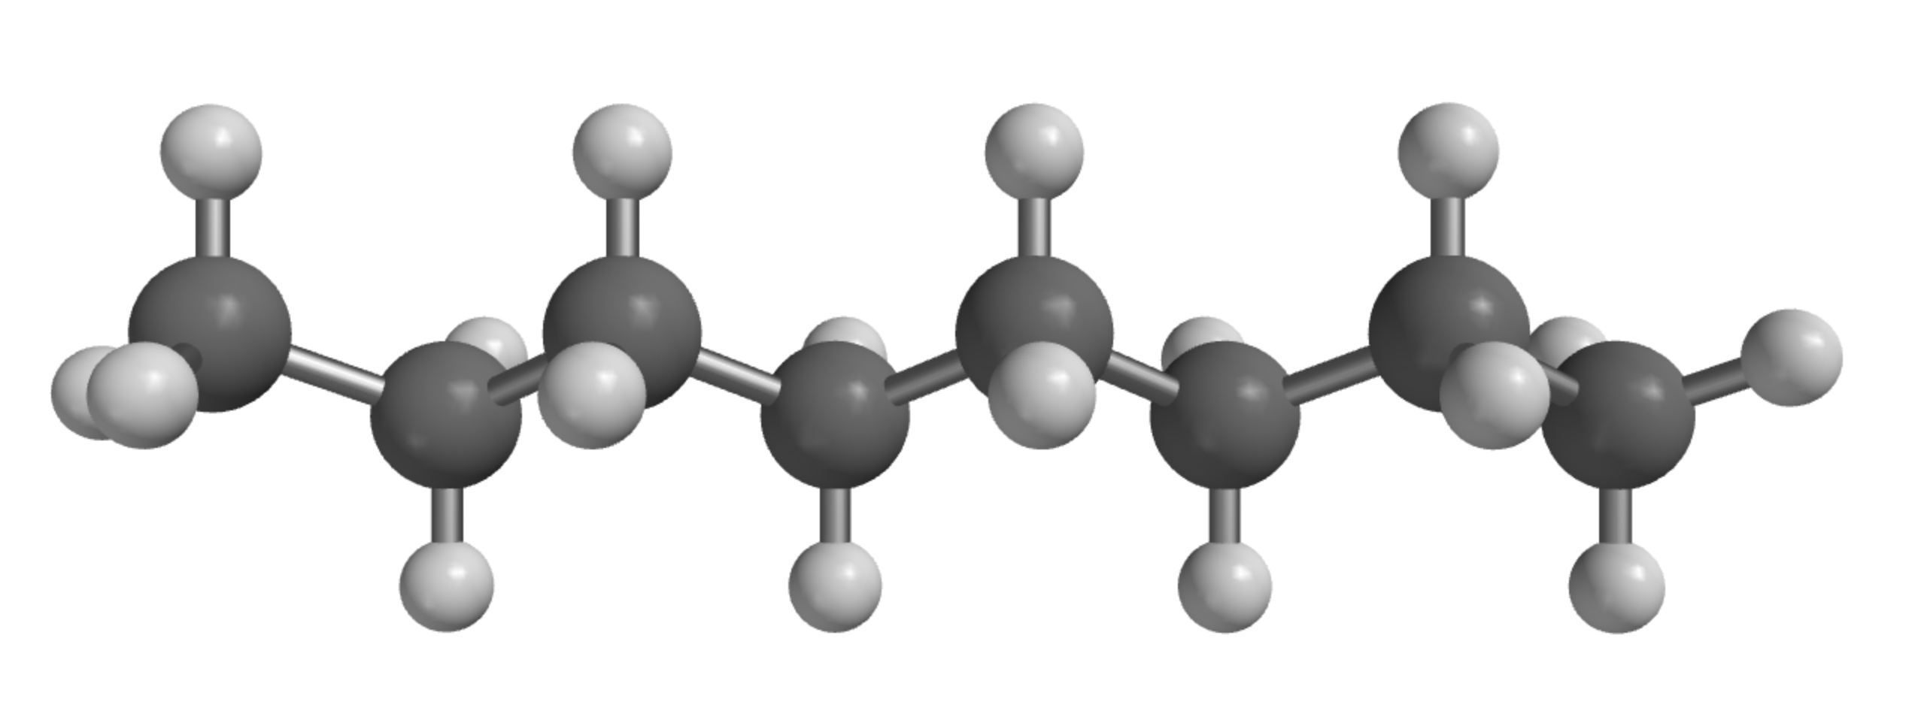
As the oil and gas move up, impermeable cap rocks can capture it
Natural gas is mostly methane
Crude oil is a mix of longer hydrocarbons (primarily propane through octane)

Slide 11
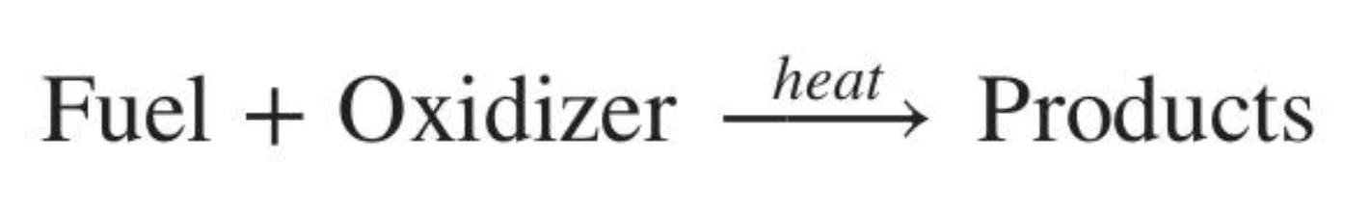
Process of combustion

Slide 12
Process of combustion
Glucose: C₆H₁₂O₆
Coal: C(s)
Oil/gas: C_{n}H_{m}(l or g)
Usually O₂
(But can be other oxidizers too)
Usually CO₂ and H₂O
(But there can be other products too … including heat!)

Slide 13
Thermochemical equations are chemical equations that also specify heat
Specifying the heat makes this a thermochemical equation

Slide 14
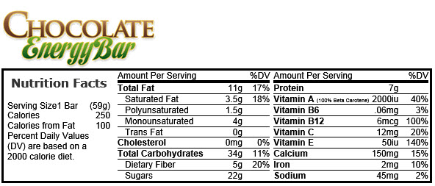
Labels on food are usually given in Calories
1 Calorie = 1000 calories = 4.18 kJ
One serving (59 g) is …
How many Calories?
How many kcal?
How many calories?
How many kilojoules?

Slide 15
Labels on food are usually given in Calories
1 Calorie = 1000 calories = 4.18 kJ
One serving (59 g) is …
How many Calories? 250
How many kcal? 250
How many calories?
How many kilojoules?

Slide 16
Labels on food are usually given in Calories
1 Calorie = 1000 calories = 4.18 kJ
One serving (59 g) is …
How many Calories? 250
How many kcal? 250
How many calories? 250,000
How many kilojoules?

Slide 17
Labels on food are usually given in Calories
1 Calorie = 1000 calories = 4.18 kJ
One serving (59 g) is …
How many Calories? 250
How many kcal? 250
How many calories? 250,000
How many kilojoules? 250 x 4.18 = 1045

Slide 18
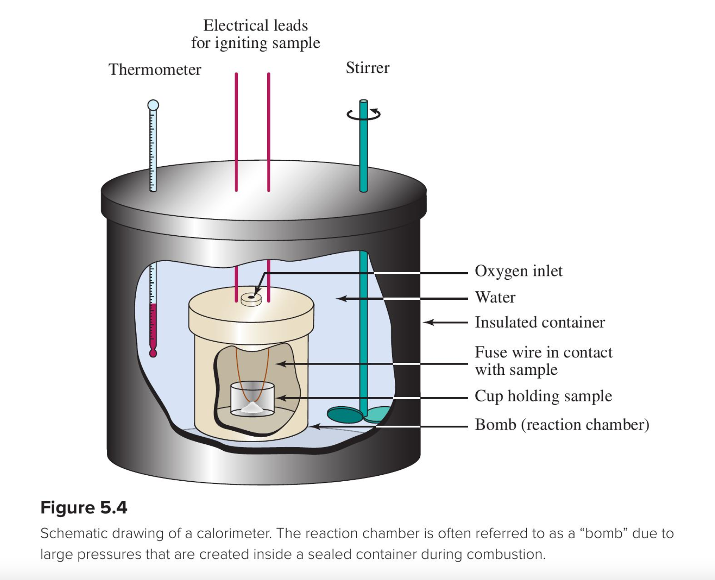
How do we know those numbers?
Bomb calorimeter
(lab)

Slide 19
Combustion reactions are always exothermic (give off heat)
The combustion of methane is exothermic, a term applied to any chemical or physical change accompanied by the release of heat.
Here, it’s understood that the energy released refers to one mole of methane

Slide 20
Heat to get started (e.g., a match) vs heat released (e.g., bonfire)
CH₄ + 2O₂
Energy
2H₂O + CO₂

Slide 21
Heat to get started (e.g., a match) vs heat released (e.g., bonfire)
1. Ignites easily at a low temperature
CH₄ + 2O₂
Energy
2H₂O + CO₂

Slide 22
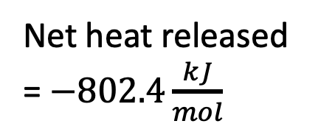
Heat to get started (e.g., a match) vs heat released (e.g., bonfire)
Bonds breaking
CH₄ + 2O₂
Net heat released = $−802.4\frac{kJ}{mol}$
Energy
2H₂O + CO₂

Slide 23
Heat to get started (e.g., a match) vs heat released (e.g., bonfire)
Bonds breaking
Bonds forming
CH₄ + 2O₂
Net heat released = $−802.4\frac{kJ}{mol}$
Energy
2H₂O + CO₂

Slide 24
Heat to get started (e.g., a match) vs heat released (e.g., bonfire)
Bonds breaking
Bonds forming
CH₄ + 2O₂
Net heat released = $−802.4\frac{kJ}{mol}$
Energy
2. Produces a lot of heat
2H₂O + CO₂

Slide 25
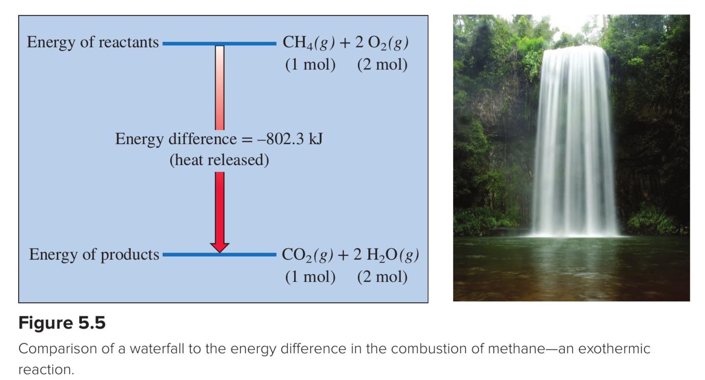
Special way to symbolize this drop in energy: $∆H_{rxn}$ in $\frac{kJ}{mol}$
$∆H_{rxn}=−802.4\frac{kJ}{mol}$

Slide 26
Just for practice … what’s $∆H_{rxn}$ for this reaction in $\frac{kcal}{mol}$?
$∆H_{rxn}=−802.4\frac{kJ}{mol} × \frac{…}{…}$

Slide 27
Just for practice … what’s $∆H_{rxn}$ for this reaction in $\frac{kcal}{mol}$?
$∆H_{rxn}=−802.4\frac{kJ}{mol} × \frac{1 kcal}{4.18 kJ}$

Slide 28
Just for practice … what’s $∆H_{rxn}$ for this reaction in $\frac{kcal}{mol}$?
$∆H_{rxn}=−802.4\frac{kJ}{mol} × \frac{1 kcal}{4.18 kJ}=−192\frac{kcal}{mol}=−192\frac{Calories}{mol}$

Slide 29
Safe transport means it should be reasonably light
Why?
Produces a lot of heat
Can be safely stored and transported
Best if you get a lot of heat per pound (or per gram or whatever) of fuel

Slide 30
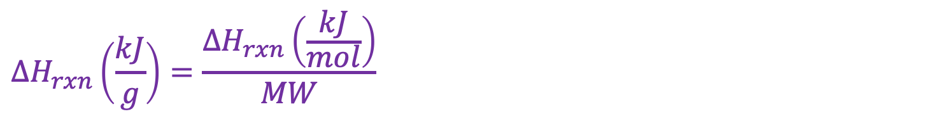
A useful conversion: $∆H_{rxn}$ in $\frac{kJ}{g}$
$$∆H_{rxn}\left(\frac{kJ}{g}\right)=\frac{∆H_{rxn}\left(\frac{kJ}{mol}\right)}{MW}$$

Slide 31
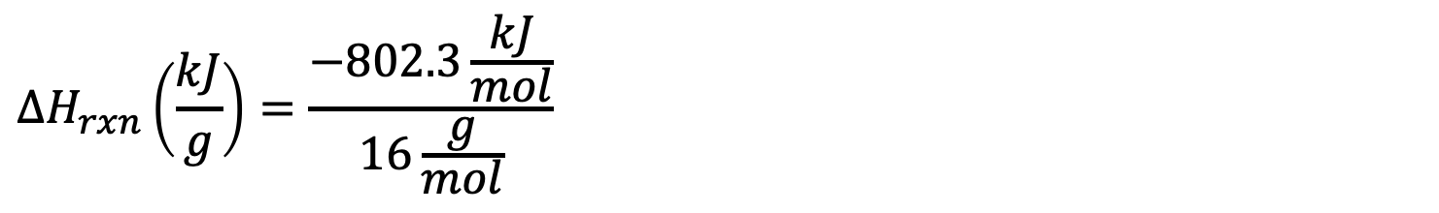
A useful conversion: $∆H_{rxn}$ in $\frac{kJ}{g}$
$$∆H_{rxn}\left(\frac{kJ}{g}\right)=\frac{−802.3\frac{kJ}{mol}}{16\frac{g}{mol}}$$

Slide 32
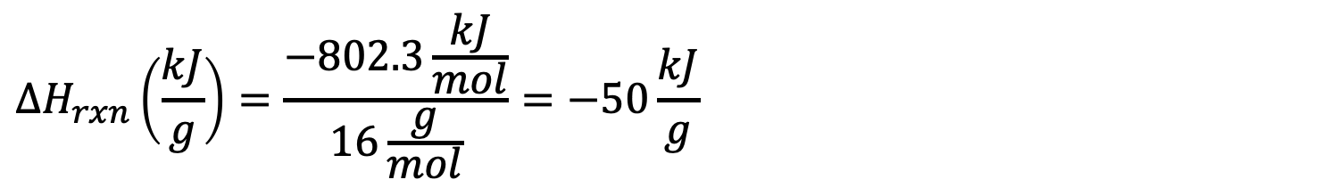
A useful conversion: $∆H_{rxn}$ in $\frac{kJ}{g}$
$$∆H_{rxn}\left(\frac{kJ}{g}\right)=\frac{−802.3\frac{kJ}{mol}}{16\frac{g}{mol}}=−50\frac{kJ}{g}$$

Slide 33
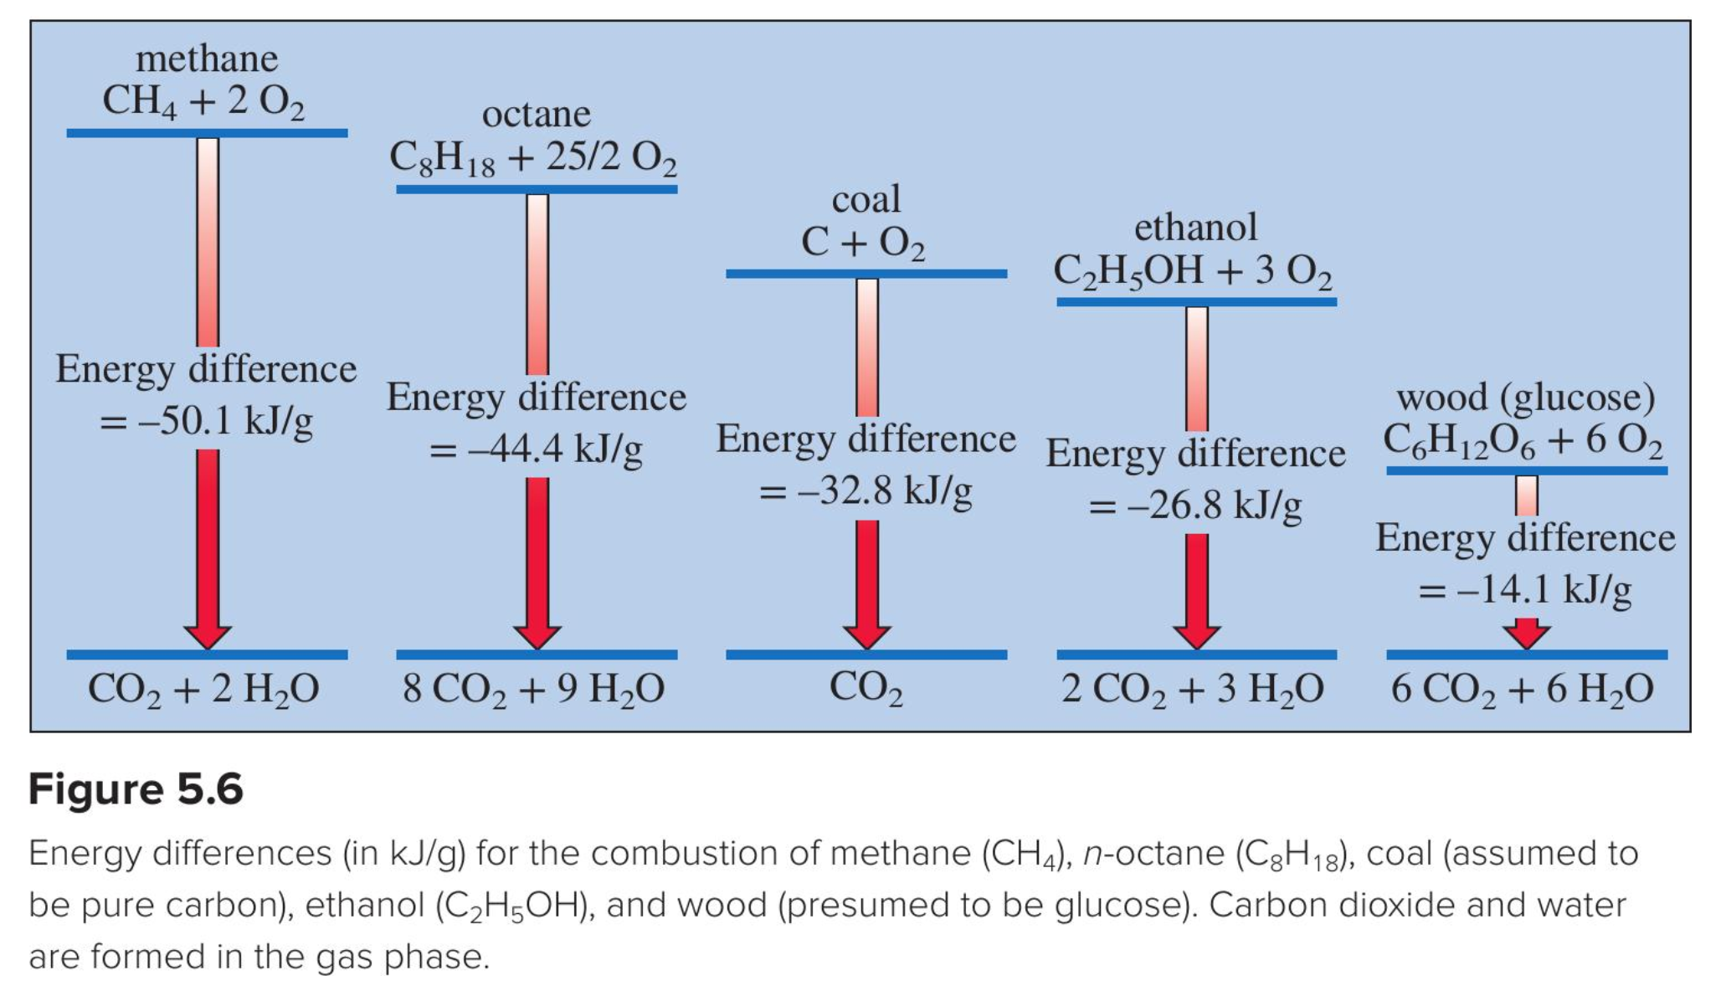
Fuel comparisons
Why is it that the more hydrogen, the better the fuel (per gram)?
Why is it that the more oxygen, the worse the fuel (per gram)?

Slide 34
Fuel comparisons
1. You’ll report on these (find in Spartan, ”Access database by name”:
2,2,4-Trimethylpentane vs n-octane
cyclooctane vs n-octane
ethanol vs methanol
ethanol vs propanol
glycerol vs 1,2-Propanediol
D-glucose vs fructose
2. I’ll report on these:
decanoic acid vs methyl decanoate
glycerol vs glyceryl tristearate
Which category do they fall under?
Hydrocarbon
Alcohol
Sugar
Acid
Ester
How are they similar/different?
of carbon atoms
H–to–C atom ratio
Straight or branched?

